Slide 1
Data Structures (DS)
Week – 01
Aug 31 & Sep 1-4, 2020
Instructor: Basit Ali
Email: Basit.jasani@nu.edu.pk
Data Structures (CS-201)

Slide 2
Objectives
To understand the design of fundamental data structures and algorithms for problem solving through computer system
To study the tradeoff choices in the design and implementation of data structures
To provide a rigorous “hands-on” experience with implementing different data structures in a high-level programming language
To analyze time/space tradeoff for different solutions to the same problem
Understand dictionary/search data structures (lists, trees, hash tables).
Understand graph representations and algorithms.

Slide 3
Objectives (cont..)
Understand time and space analysis for both iterative and recursive algorithms and be able to prove the correctness a non-trivial algorithm.
Be able to translate high-level, abstract data structure descriptions into concrete code.
Understand how real-world problems map to abstract graph problems.
Be able to communicate clearly and precisely about the correctness and analysis of basic algorithms (both oral and written communication).

Slide 4
Objectives (cont..)
Data structures will include lists, vectors, queues, stacks, trees, hash-tables, and graphs.
Algorithms include searching, sorting using the above data structures, iterative, and recursive algorithms
On assignments, students are asked to implement data structures and algorithms using a high-level programming language.
On exams, students are asked to solve problems using analytical methods and programming skills acquired from lectures and assignments to demonstrate knowledge and comprehension of course material.

Slide 5
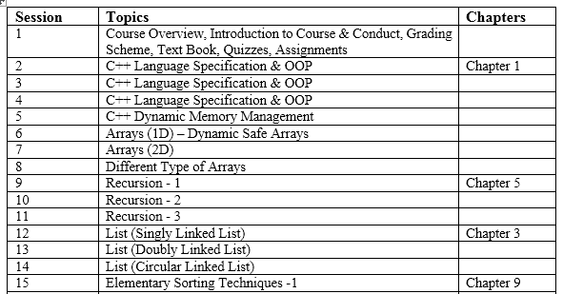
Course Outline

Slide 6
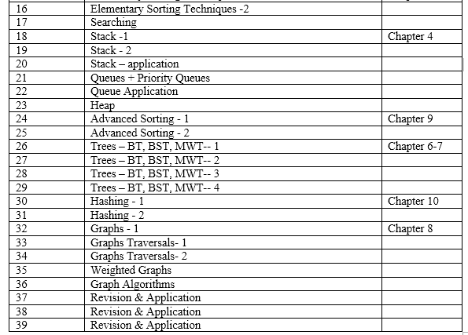
Course Outline (cont..)

Slide 7
Book & References
Prerequisites
OOP
Text Book
Data Structures and Algorithms in C++ 4th Edition- by Adam Drozdek
Data Structures & Algorithm Analysis in C++ (3rd Edition). Mark Allen Weiss
Other Reference
C++ How to Program, 5th edition, H. M. Deitel, P. J. Deitel

Slide 8
Marks Distribution
Assignments: 20 %
Projects : 10 %
Two exams: 20 %
Quiz : 10 %
Final Exam: 40 %

Slide 9
What this course is about ?
Data structures: conceptual and concrete ways to organize data for efficient storage and efficient manipulation
Employment of this data structures in the design of efficient algorithms
Analysis of the complexity of your algorithms

Slide 10
Why do we need them?
Requirements for a good software:
Clean Design
Easy maintenance
Reliable (no core dumps)
Easy to use
Fast algorithms
Efficient data structures
Efficient algorithms

Slide 11
Tentative Topics
Algorithm Analysis
Arrays, Stacks and Queues
Vectors, lists and sequences
Trees
Heaps / Priority Queues
Binary Search Trees –
Search Trees
Hashing / Dictionaries
Sorting
Graphs and graph algorithms

Slide 12
What will you learn?
What are some of the common data structures
What are some ways to implement them
How to analyze the complexity of your algorithms using the data structures
How to use them to solve practical problems

Slide 13
C++ (OOP) warm-up
Basic features
Parameter passing
Classes
Inheritance and virtual
Four Pillars of OOP
Abstract Data Types
Header file
IO
Memory Management
Big three: destructor, copy constructor, and assignment operator
Const
Template

Slide 14
Object Oriented Programming
The emphasis is on creating a set of tools which can be used cleanly, with a minimum knowledge about implementation in the user’s driver files.

Slide 15
Classes and Objects
Class: a type definition that includes both
data properties, and
operations permitted on that data
Object: a variable that
is declared to be of some Class
therefore includes both data and operations for that data
Appropriate usage:
“A variable is an instance of a type.”
“An object is an instance of a class.”

Slide 16
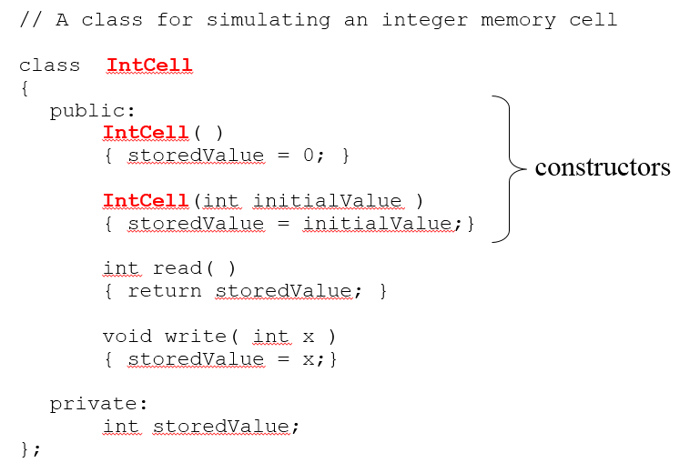
Class syntax - Example

Slide 17
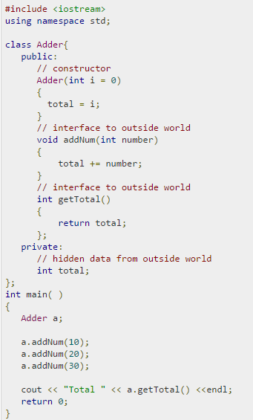
Data Abstraction
Providing only essential information to the
outside world and hiding their background details,
i.e., to represent the needed information
in program without presenting the details

Slide 18
Information hiding
Restrict access to data so that it can be
manipulated only in authorized ways.
Separate class declarations from
implementation (e.g. public, private in C++).

Slide 19
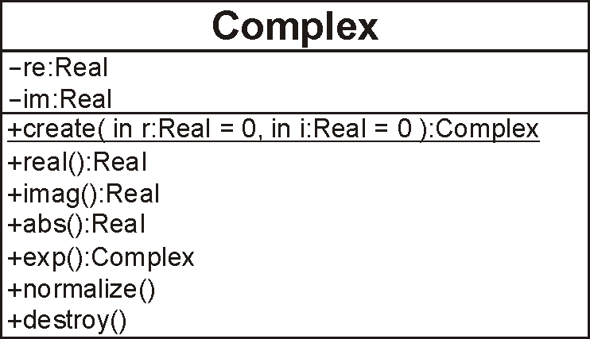
UML Class Diagrams
The Class Diagram for what we describe may be shown as the following box:

Slide 20
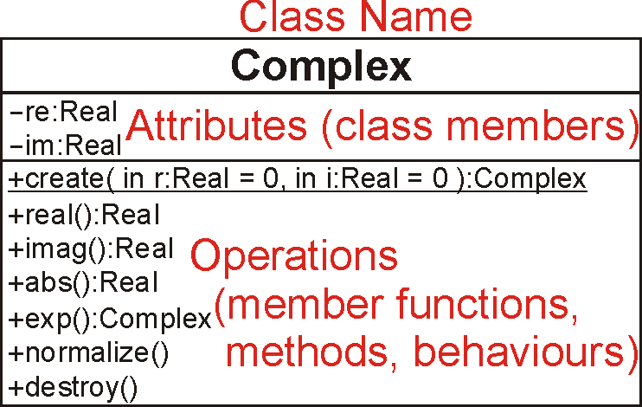
UML Class Diagrams
The three components include:
the name, the attributes, and the operations

Slide 21
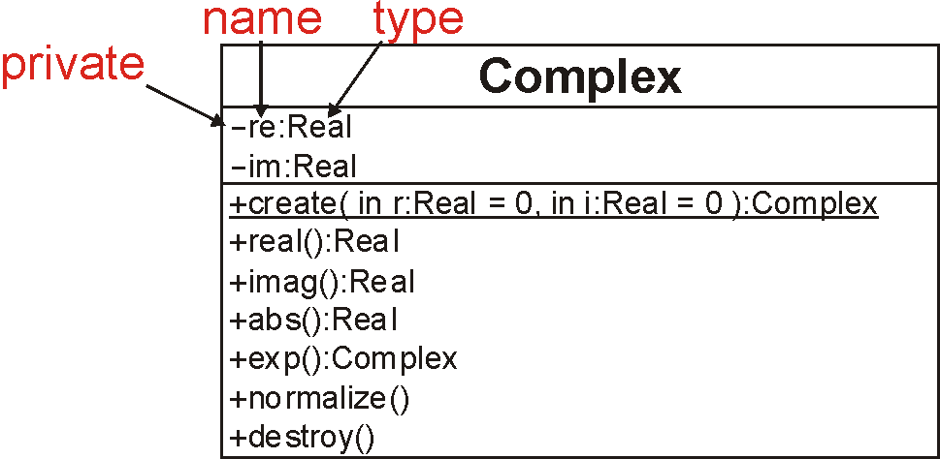
UML Class Diagrams
The attributes are described by:
a visibility modifier, a name, and a type

Slide 22
Visibility
Visibility in C# and Java is described by placing public/private/protected in front of each class member or member function
In C++, this is described by a block prefixed by one of
private:
protected:
public:

Slide 23
Accessors and Mutators
We can classify member functions into two categories:
Those leaving the object unchanged
Those modifying the member variables of the object
Respectively, these are referred to as:
Accessors: we are accessing and using the class members
Mutators: we are changing—mutating—the class members

Slide 24
Templates
This mechanism uses a tool called templates
A function has parameters which are of a specific type
A template is like a function, however, the parameters themselves are types

Slide 25
Templates
That mechanism is called a template:
template <typename Type>
Type sqr( Type x ) {
return x*x;
}
This creates a function which returns something of the same type as the argument

Slide 26
Pointers and const
There are two different ways that pointers and const can be intermixed:
Constant pointer
Pointer to a constant variable

Slide 27
Constant Pointer
A const pointer must be initialized to a value upon declaration, and its value can not be changed.
However, because the value being pointed to is still non-const, it is possible to change the value being pointed to via dereferencing the pointer:
int *const p = &i;
*p = 6; // it is O.K.
I = 10;
I++;
p = &j; // NOT O.K.

Slide 28
Pointer to a const variable
It is also possible to declare a pointer to a constant variable by using the const before the data type:
int i;
const int * p = &i;
*p = 6; // it is NOT O.K., because i is
//treated as constant when accessed by p.
P = &m;
M = 7;
*p = 7; //
However, it can be changed independently:
i = 6; // It is O.K.
It is also possible to declare a const pointer to a constant value:
const int n = 5;
const int * const p = &n;
*p = 10;
P = &x;

Slide 29
Parameter Passing
In C, all parameters are passed by value (call by value). But C++ offers three options:
Call by value
Copy of data passed to function
Changes to copy do not change original
Call by reference
Uses &
Avoids a copy and allows changes to the original
Call by constant reference
Uses const&
Avoids a copy and guarantees that actual parameter will not be changed

Slide 30
Example
#include <iostream>
using std::cout;
using std::endl;
int squareByValue( int ); // pass by value
void squareByReference( int & ); // pass by reference
int squareByConstReference ( const int & ); // const ref.
int main()
{ int x = 2, z = 4, r1, r2;
r1 = squareByValue(x);
squareByReference( z );
r2 = squareByConstReference(x);
cout << "x = " << x << " z = “ << z << endl;
cout << “r1 = " << r1 << " r2 = " << r2 << endl;
return 0;
}

Slide 31
Pointers to Functions

Slide 32
static Class Members
Shared by all objects of a class
Normally, each object gets its own copy of each variable
Efficient when a single copy of data is enough
Only the static variable has to be updated
May seem like global variables, but have class scope
Only accessible to objects of same class
Exist even if no instances (objects) of the class exist
Can be variables or functions
public, private, or protected

Slide 33
Standard Template Library
I/O Facilities: iostream
Garbage-collected String class
Containers
vector, list, queue, stack, map, set
Numerical
complex
General algorithms
search, sort

Slide 34
Using the vector
Vector: Dynamically growing, shrinking array of elements
To use it include library header file:
#include <vector>
Vectors are declared as
vector<int> a(4); //a vector called a,
//containing four integers
vector<int> b(4, 3); //a vector of four
// elements, each initialized to 3.
vector<int> c; // 0 int objects
The elements of an integer vector behave just like ordinary integer variables a[2] = 45;

Slide 35
Manipulating vectors
The size() member function returns the number of elements in the vector.
a.size() returns a value of 4.
The = operator can be used to assign one vector to another.
e.g. v1 = v2, so long as they are vectors of the same type.
The push_back() member function allows you to add elements to the end of a vector.

Slide 36
push_back() and pop_back()
vector<int> v;
v.push_back(3);
v.push_back(2);
// v[0] is 3, v[1] is 2, v.size() is 2
v.pop_back();
int t = v[v.size()-1]; //t=3
v.pop_back();

Slide 37
Inheritance
OO allow for creating a hierarchy of classes so that objects do not have to be instantiations of a single class.

